Slide 1
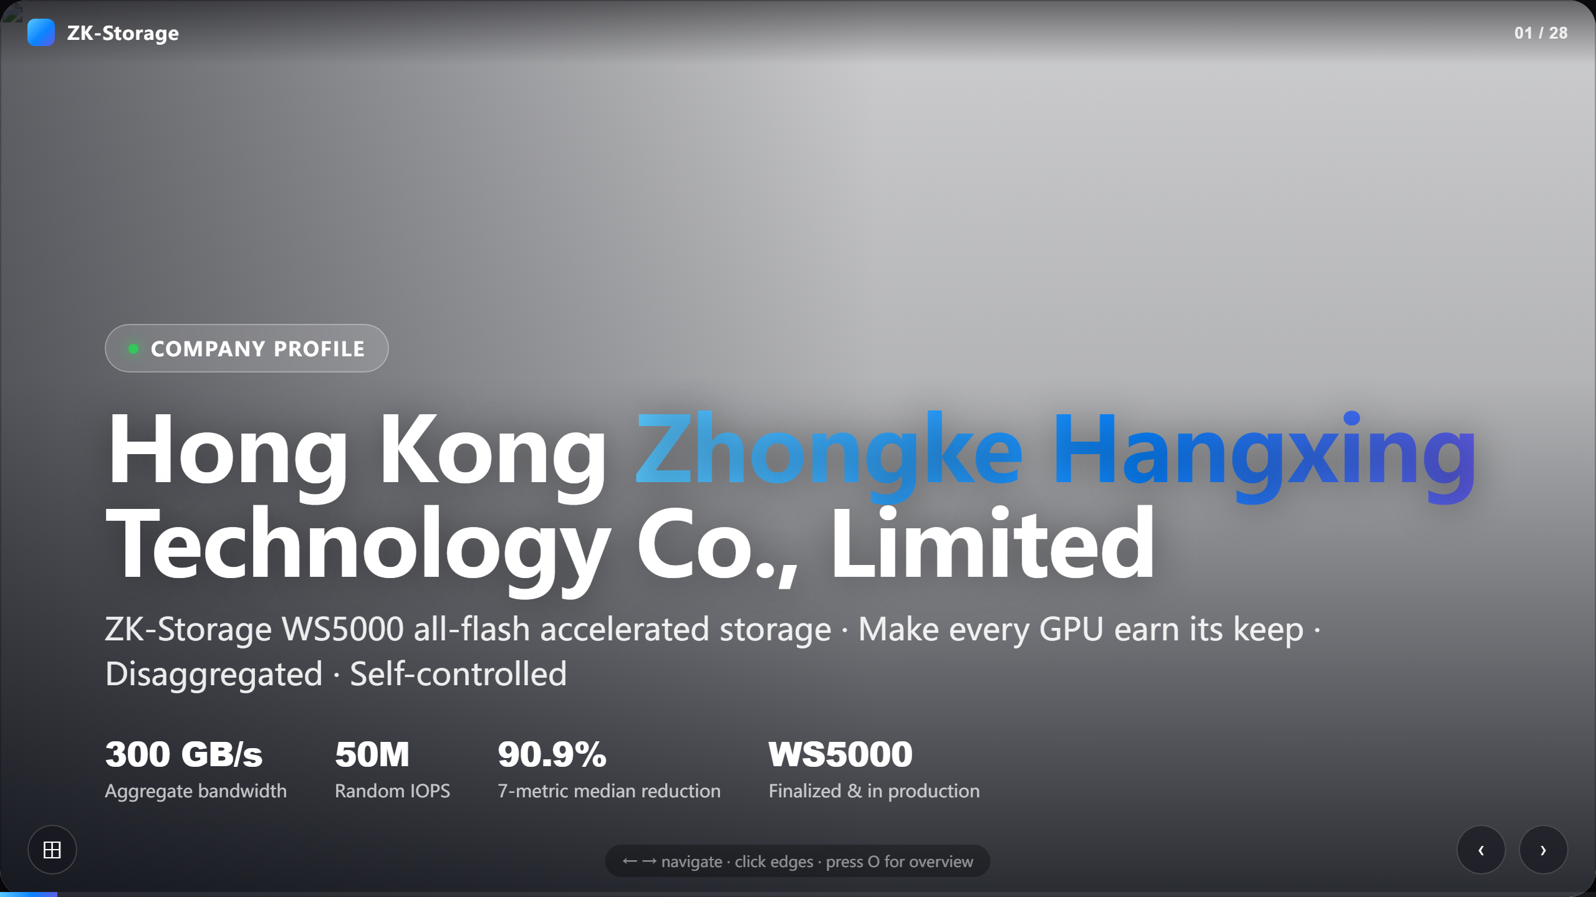
Notes:
Hong Kong Zhongke Hangxing Technology Co., Limited

Slide 2
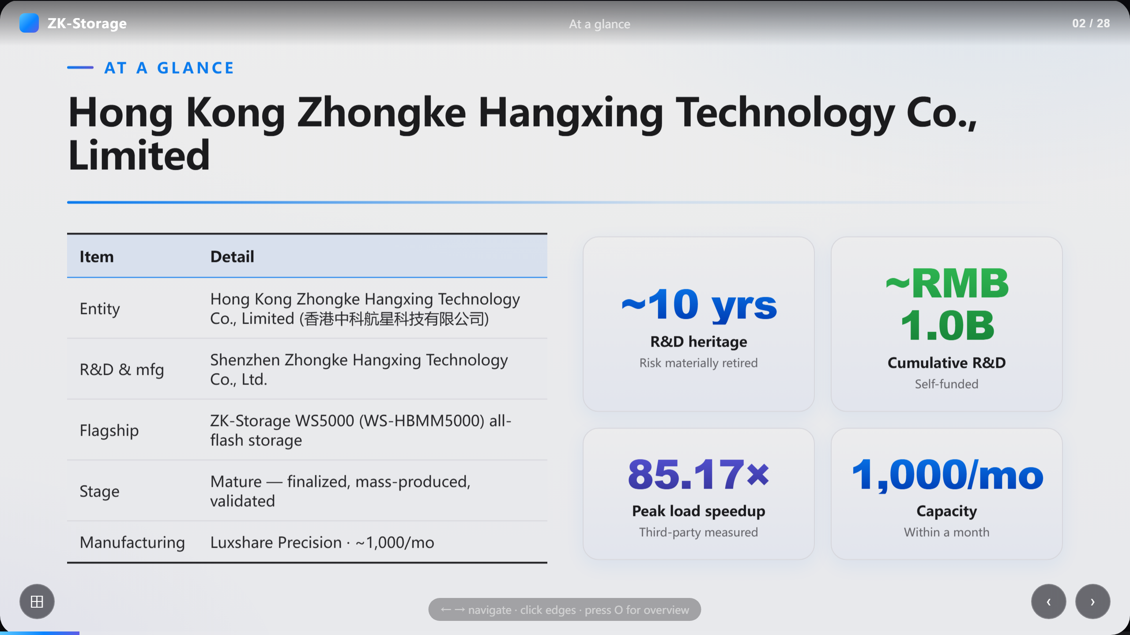
Notes:
Hong Kong Zhongke Hangxing Technology Co., Limited

Slide 3
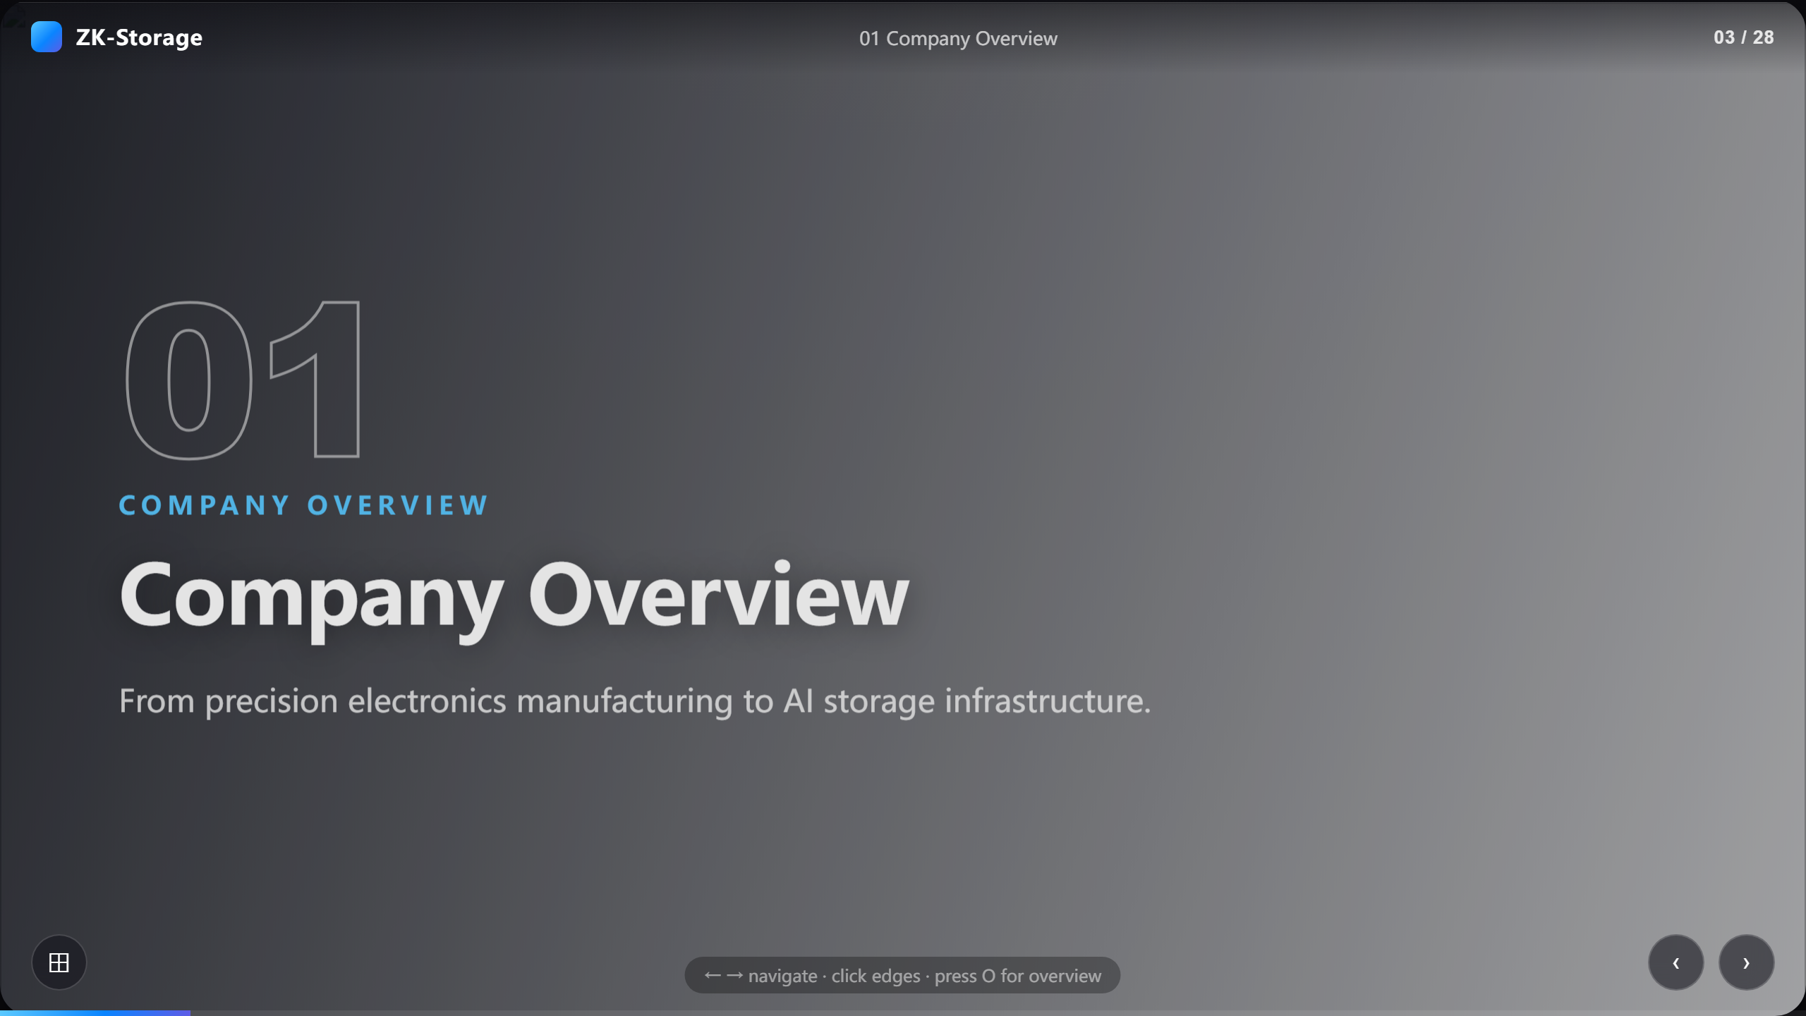
Notes:
Company Overview

Slide 4
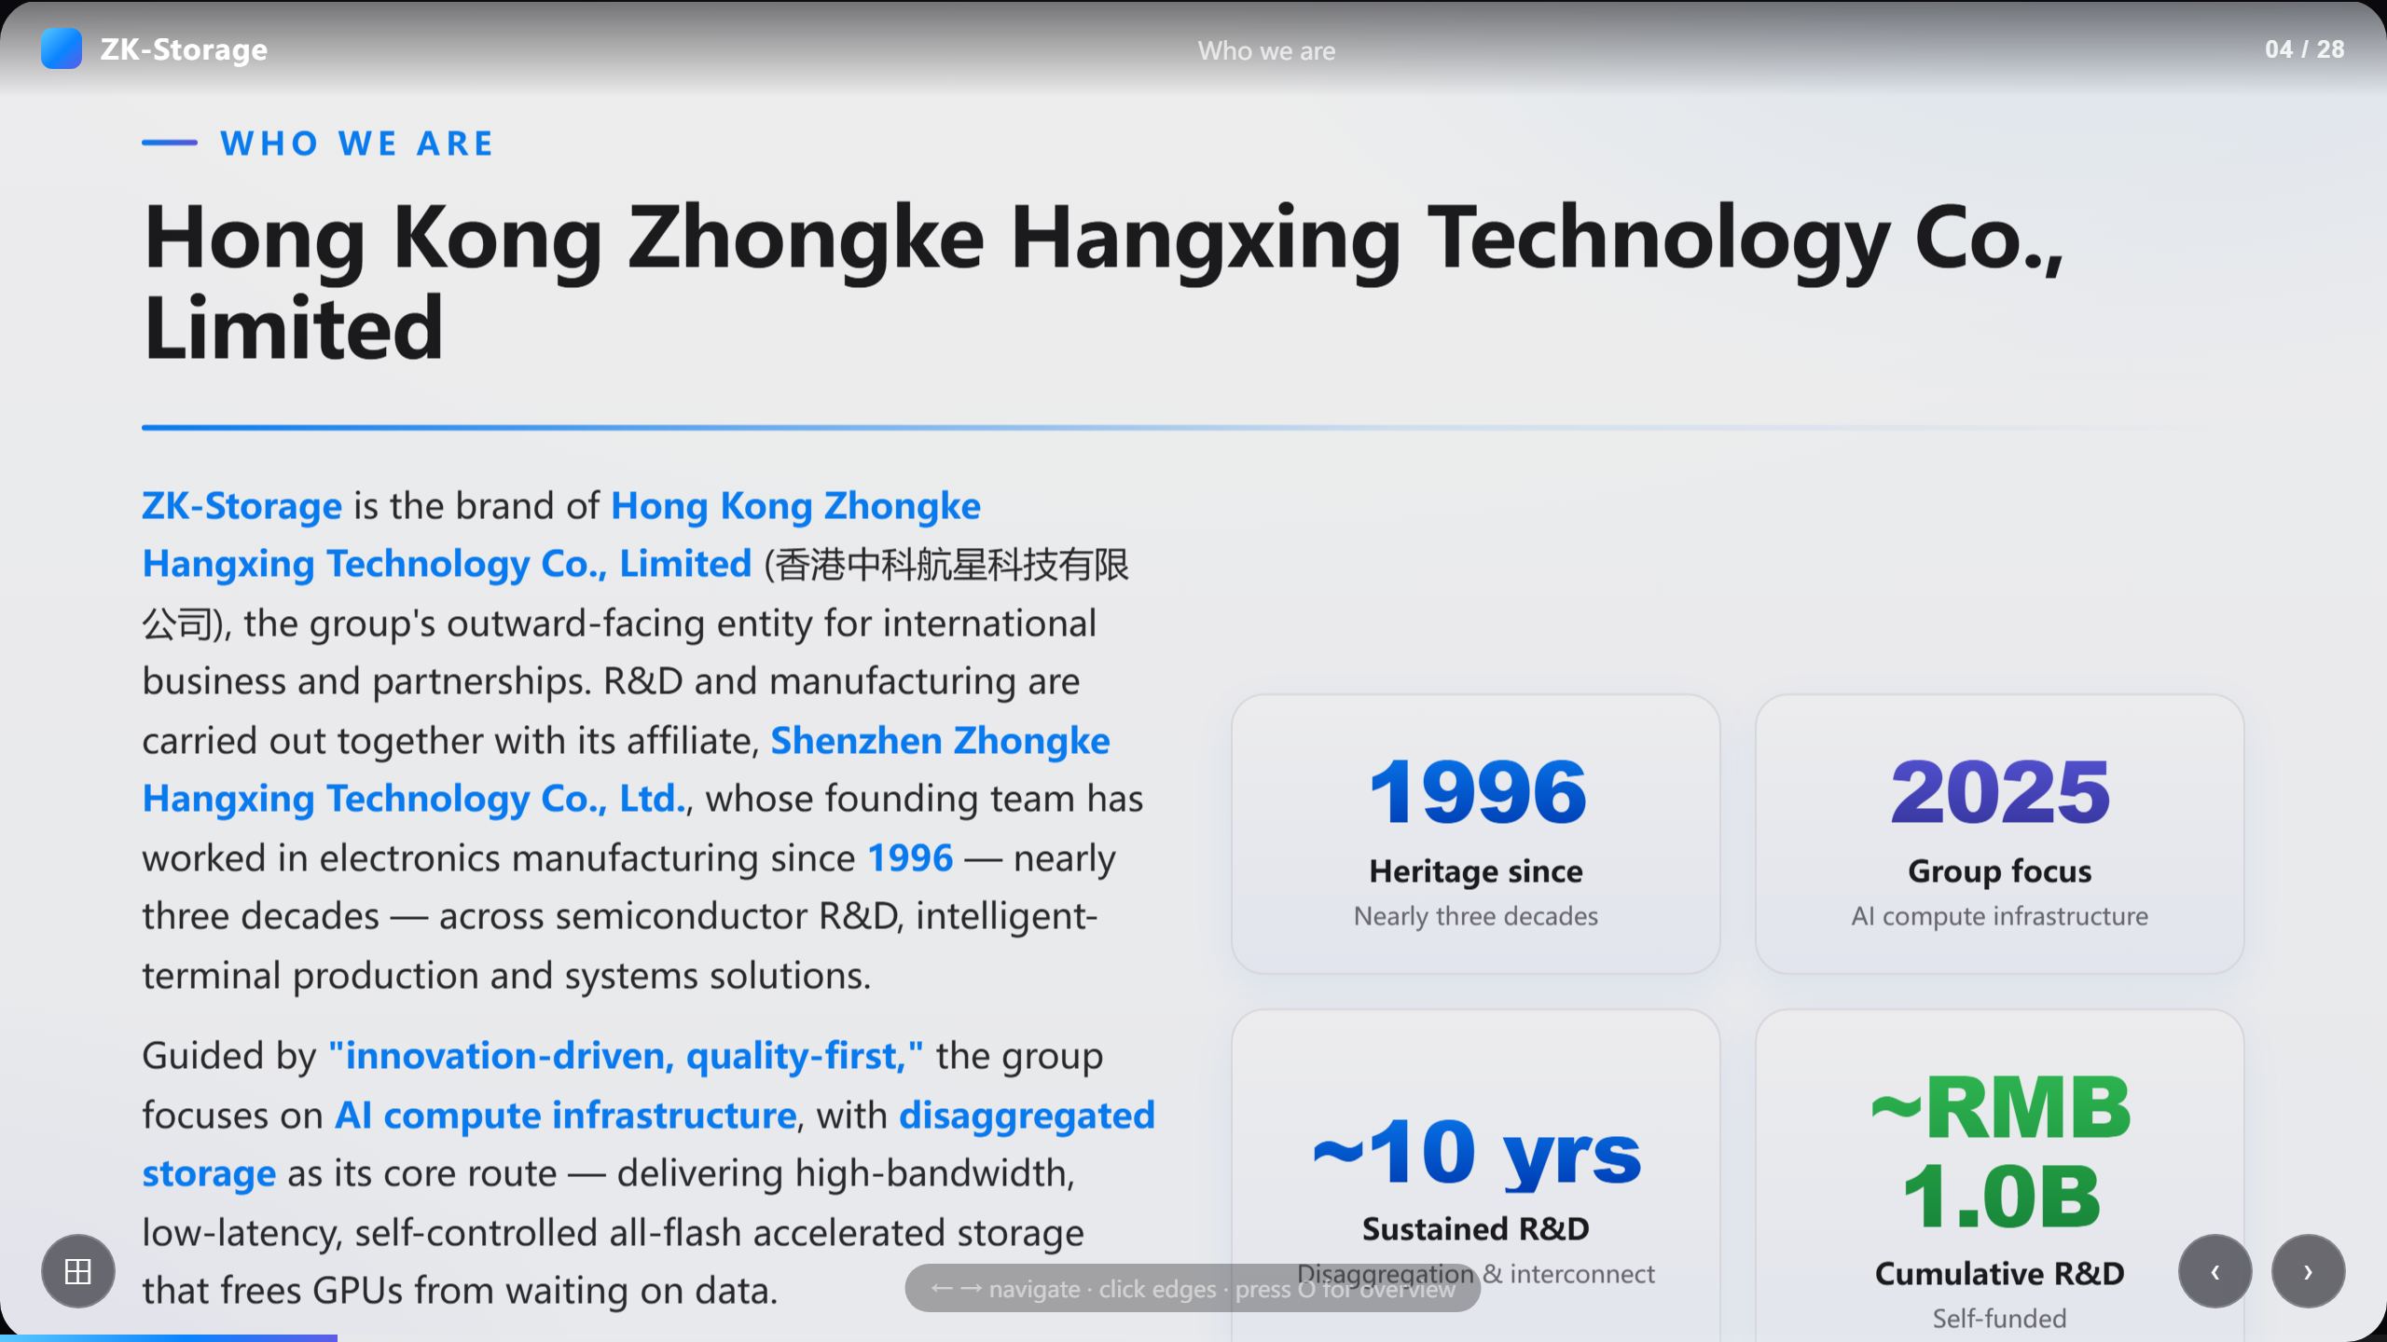
Notes:
Hong Kong Zhongke Hangxing Technology Co., Limited

Slide 5
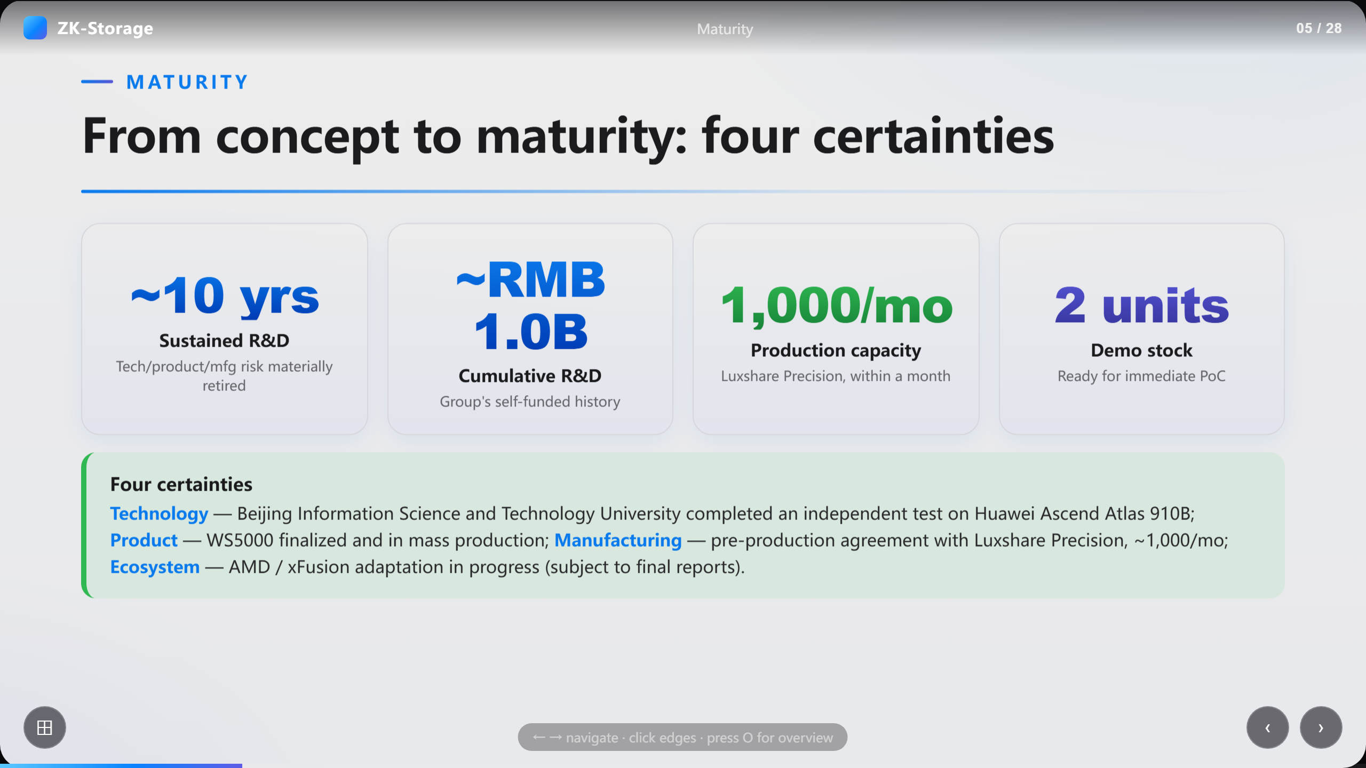
Notes:
From concept to maturity: four certainties

Slide 6
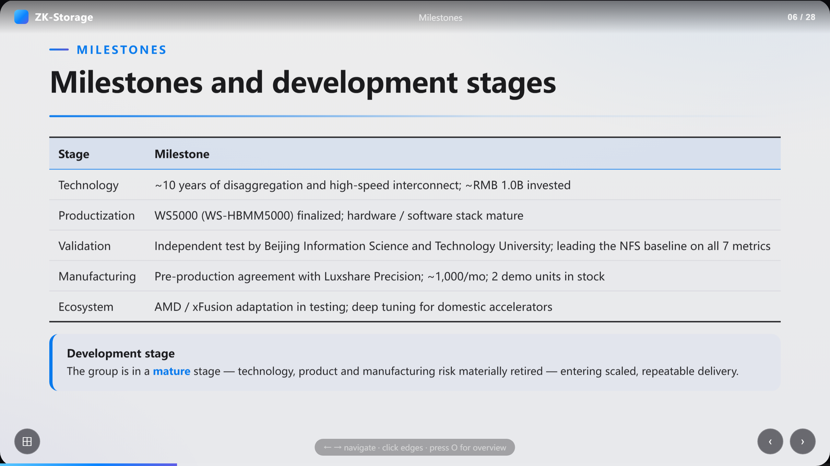
Notes:
Milestones and development stages

Slide 7
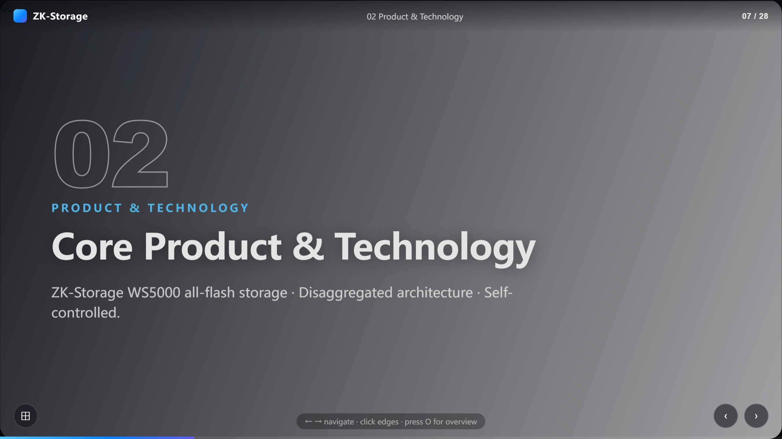
Notes:
Core Product & Technology

Slide 8
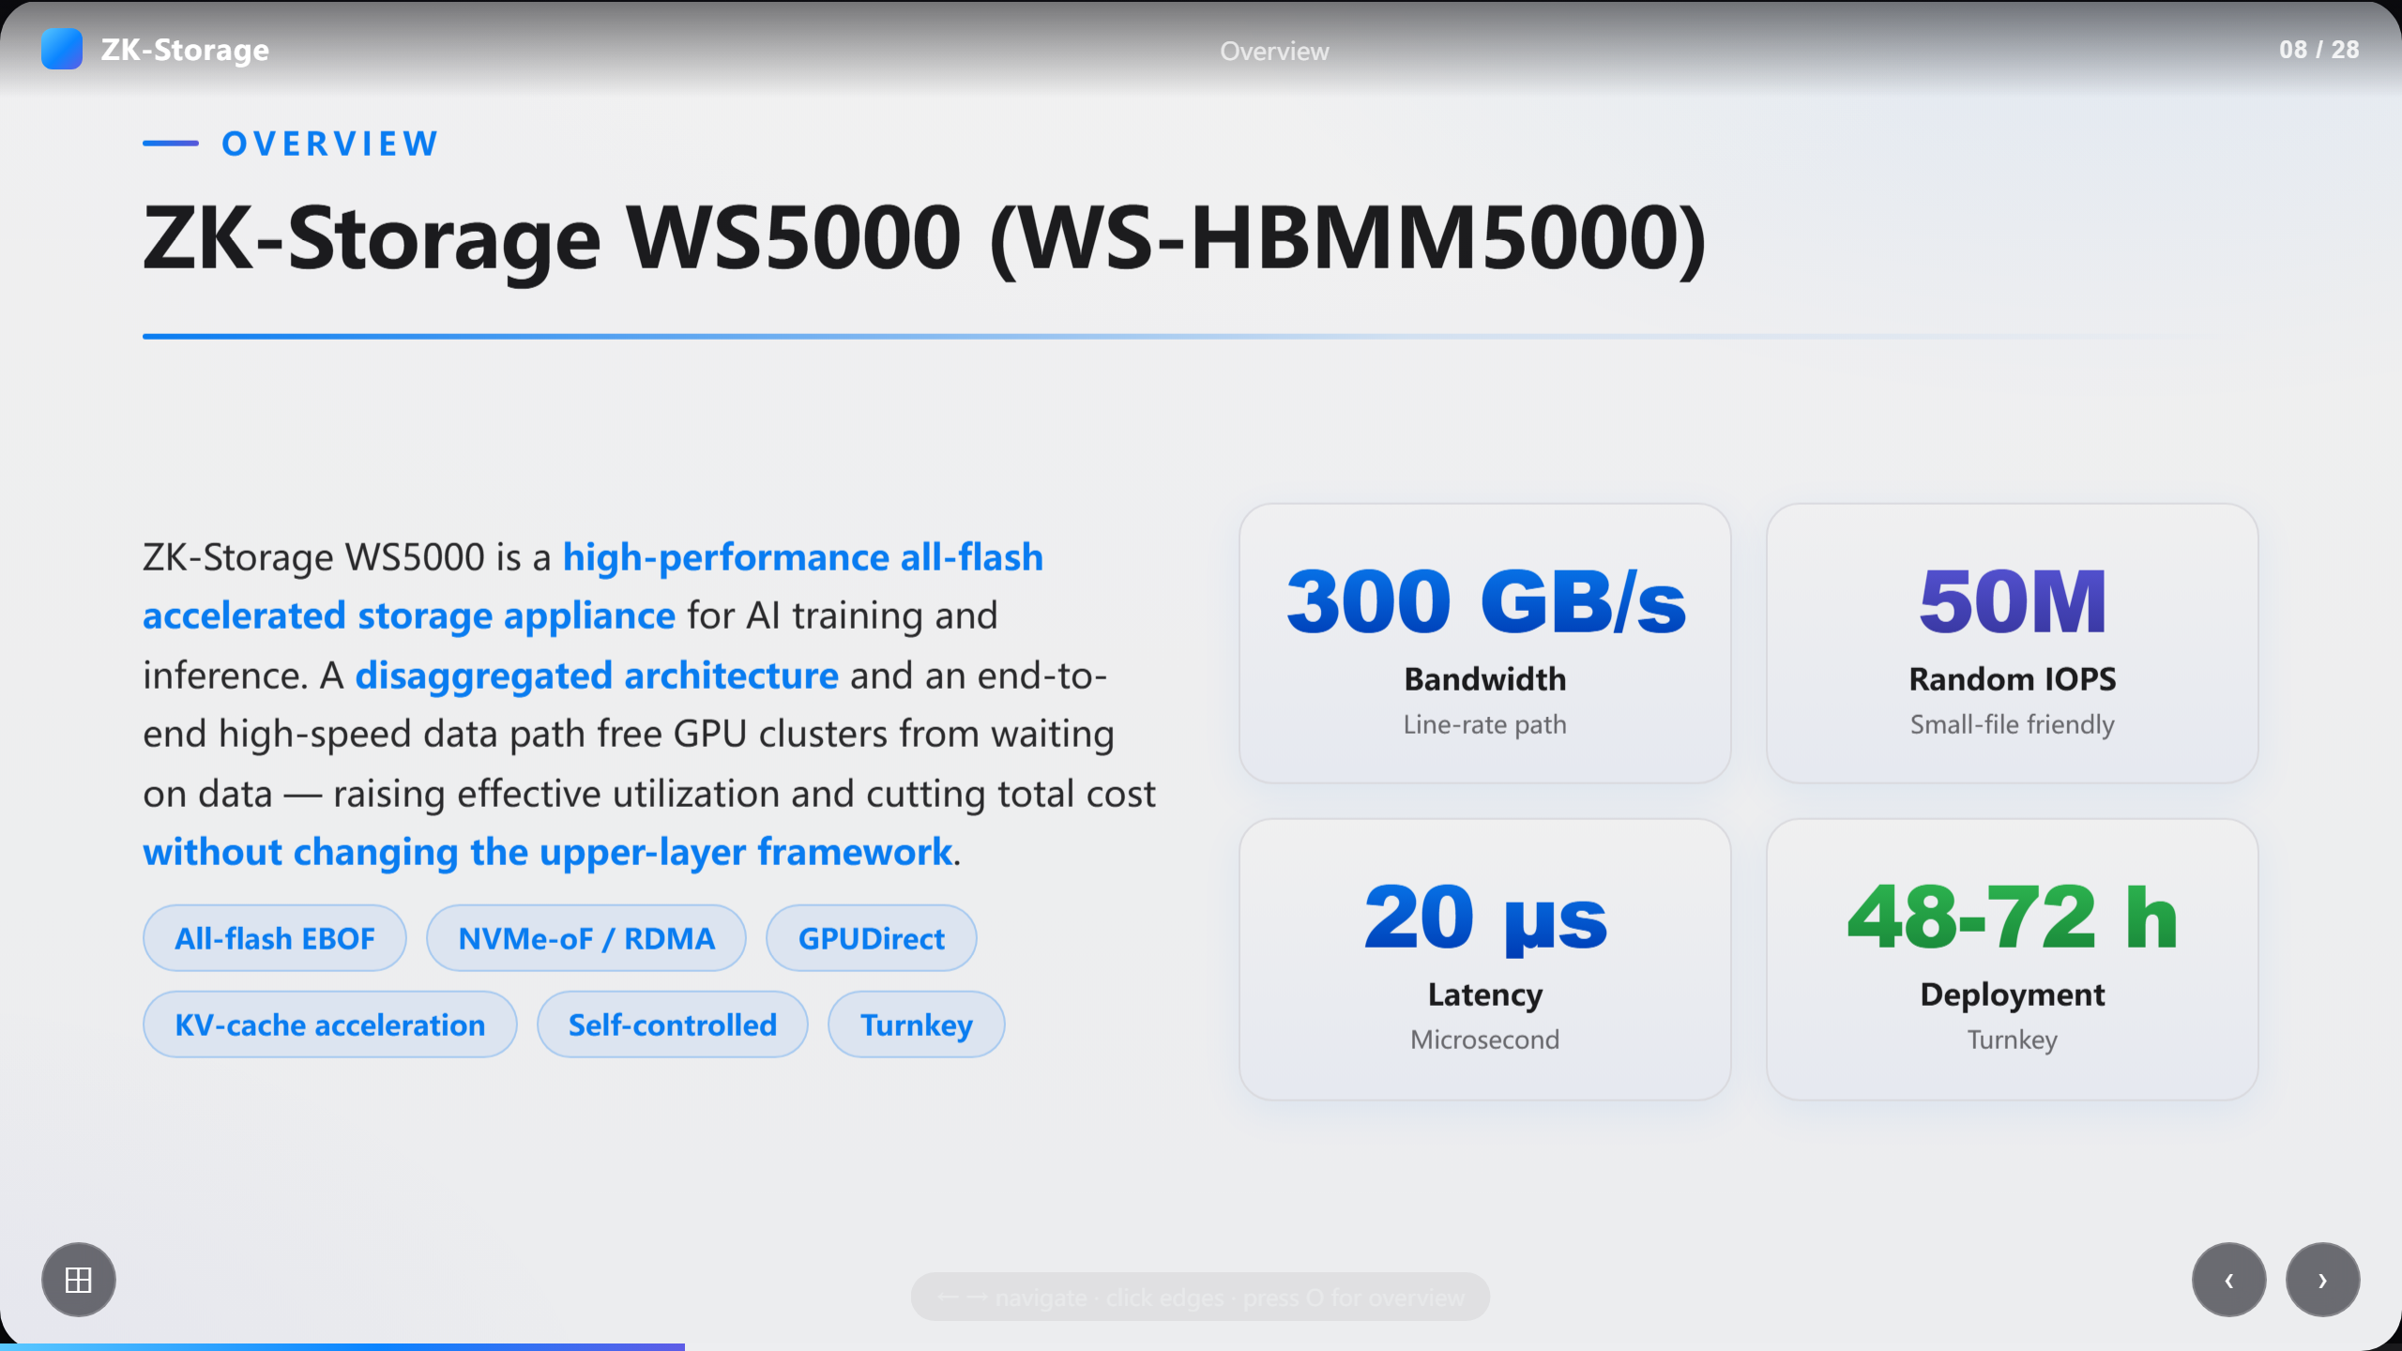
Notes:
ZK-Storage WS5000 (WS-HBMM5000)

Slide 9
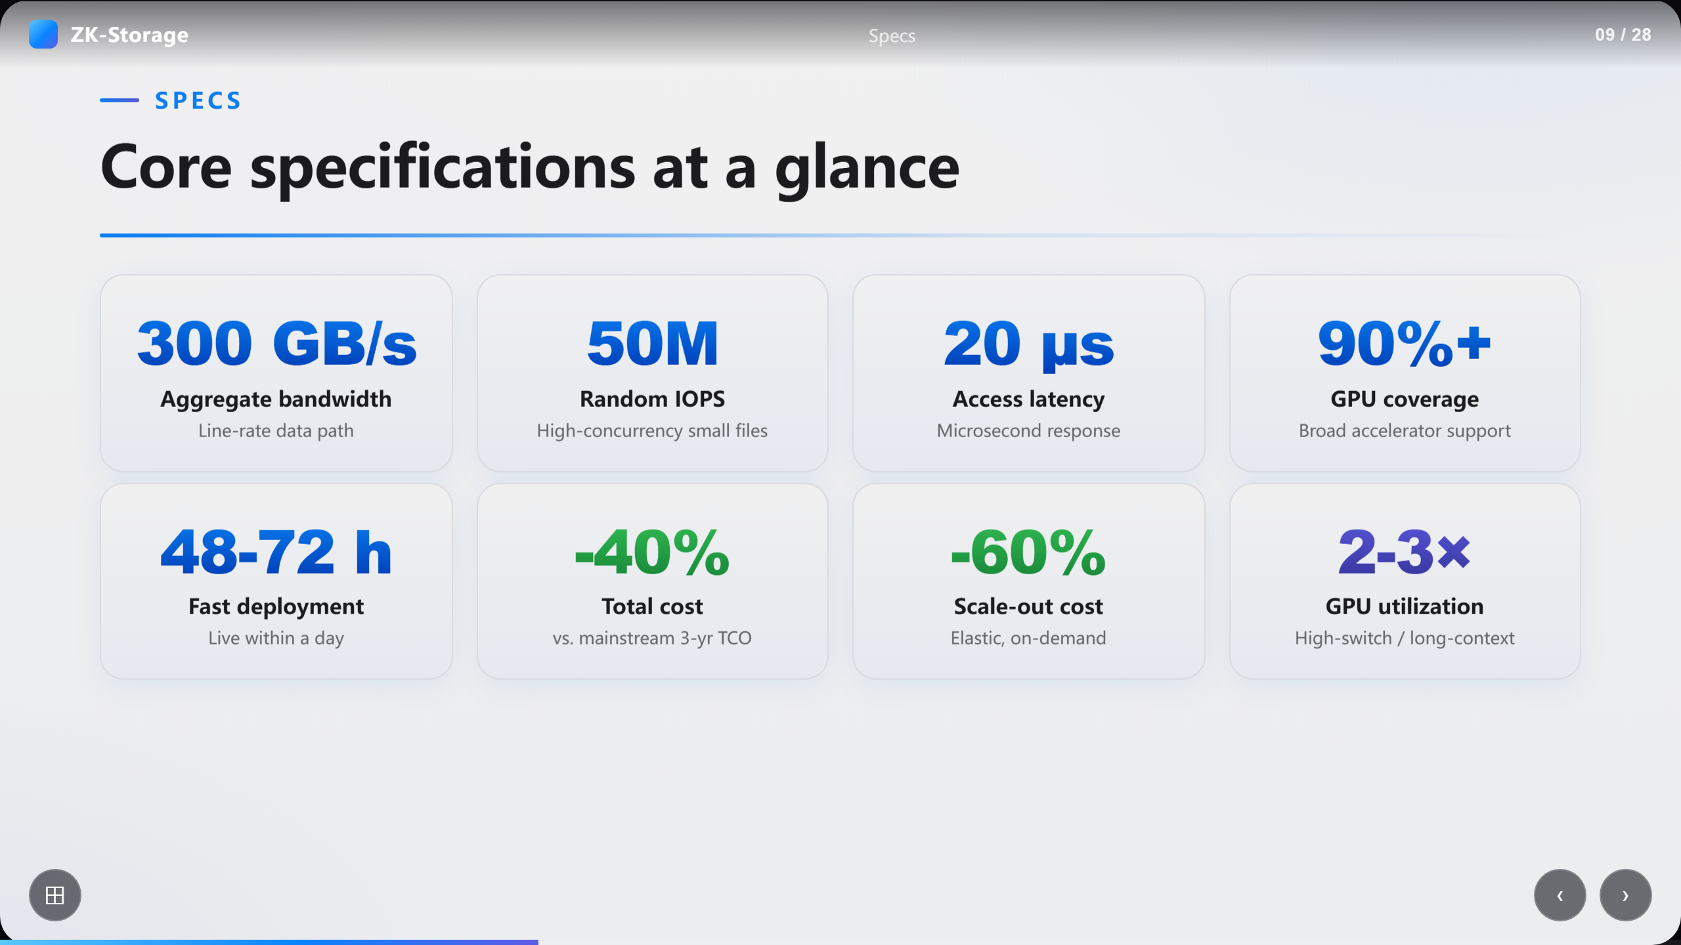
Notes:
Core specifications at a glance

Slide 10
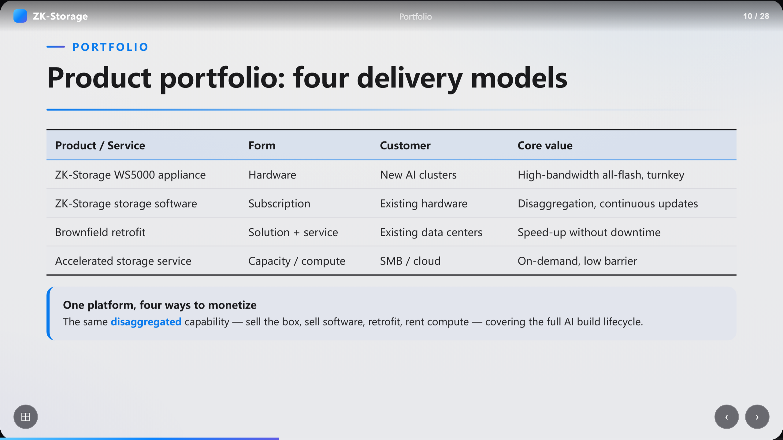
Notes:
Product portfolio: four delivery models

Slide 11
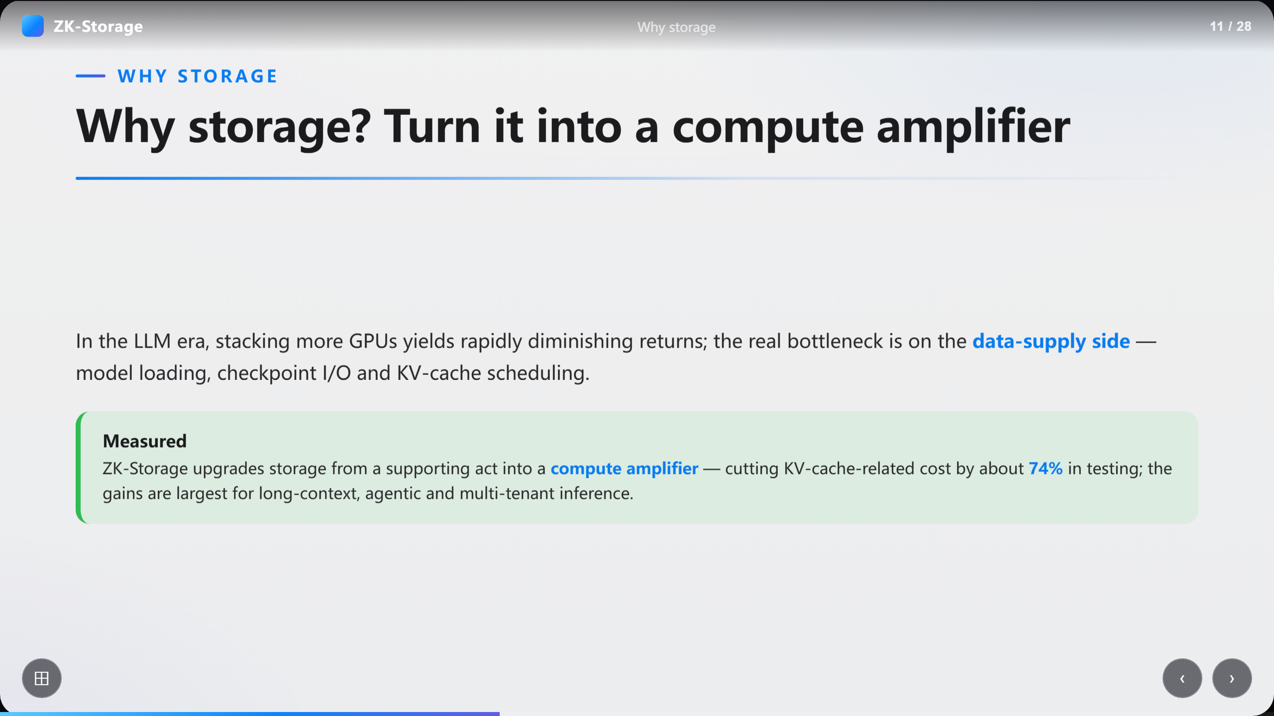
Notes:
Why storage? Turn it into a compute amplifier

Slide 12
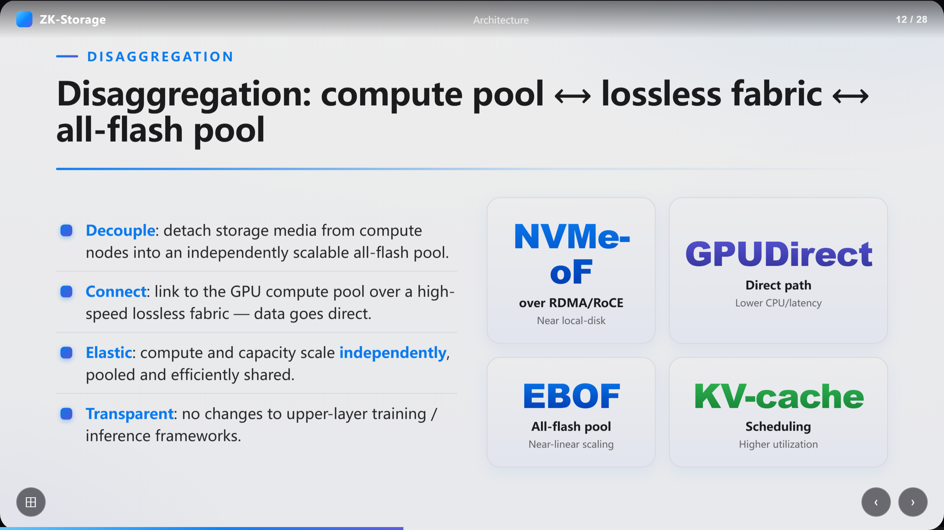
Notes:
Disaggregation: compute pool ⟷ lossless fabric ⟷ all-flash pool

Slide 13
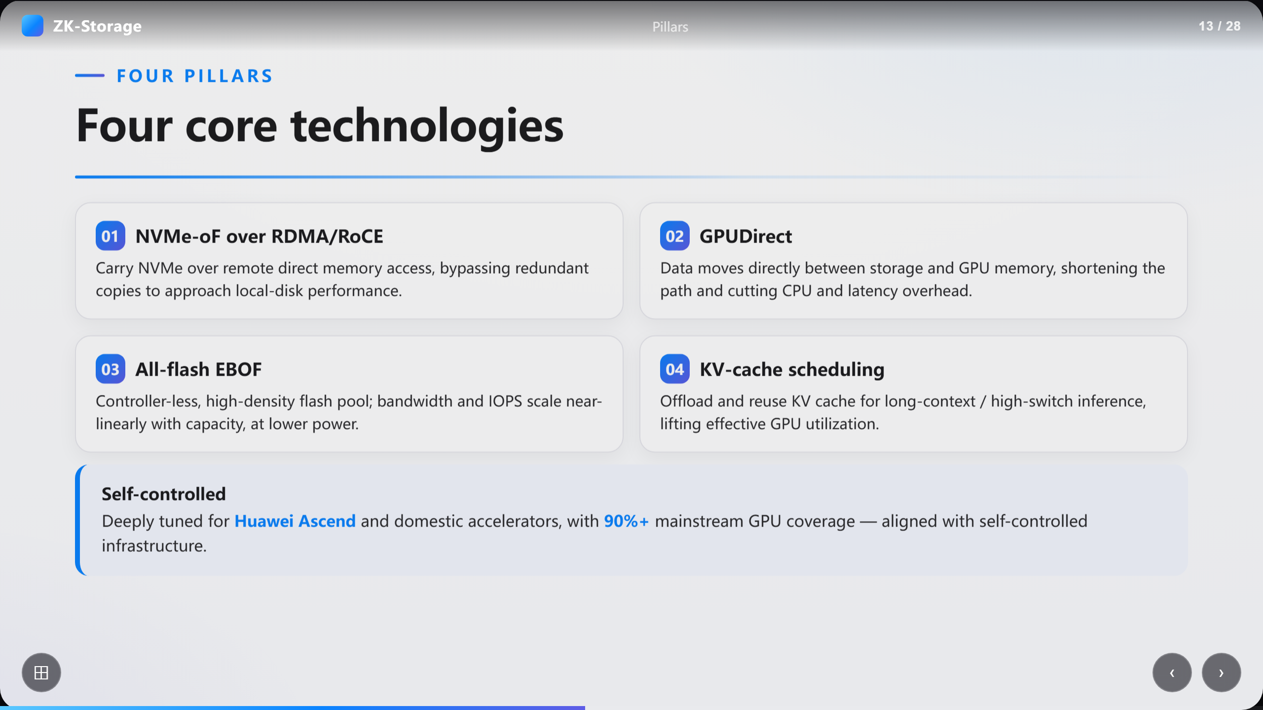
Notes:
Four core technologies

Slide 14
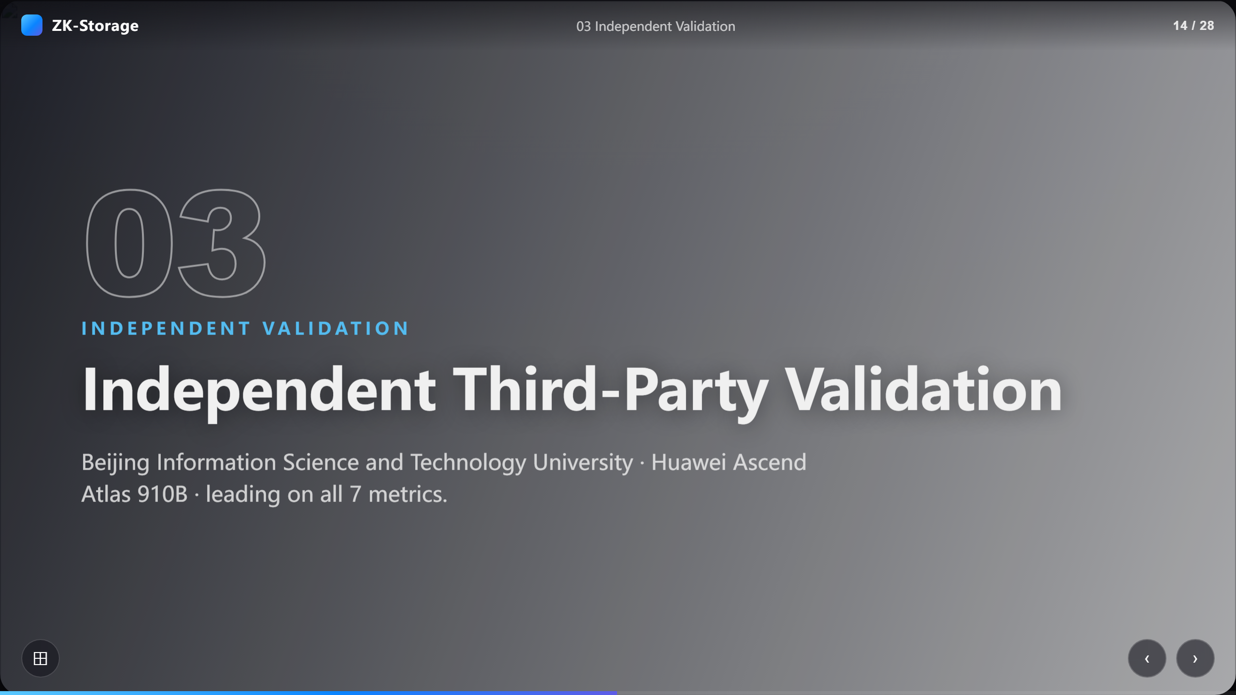
Notes:
Independent Third-Party Validation

Slide 15
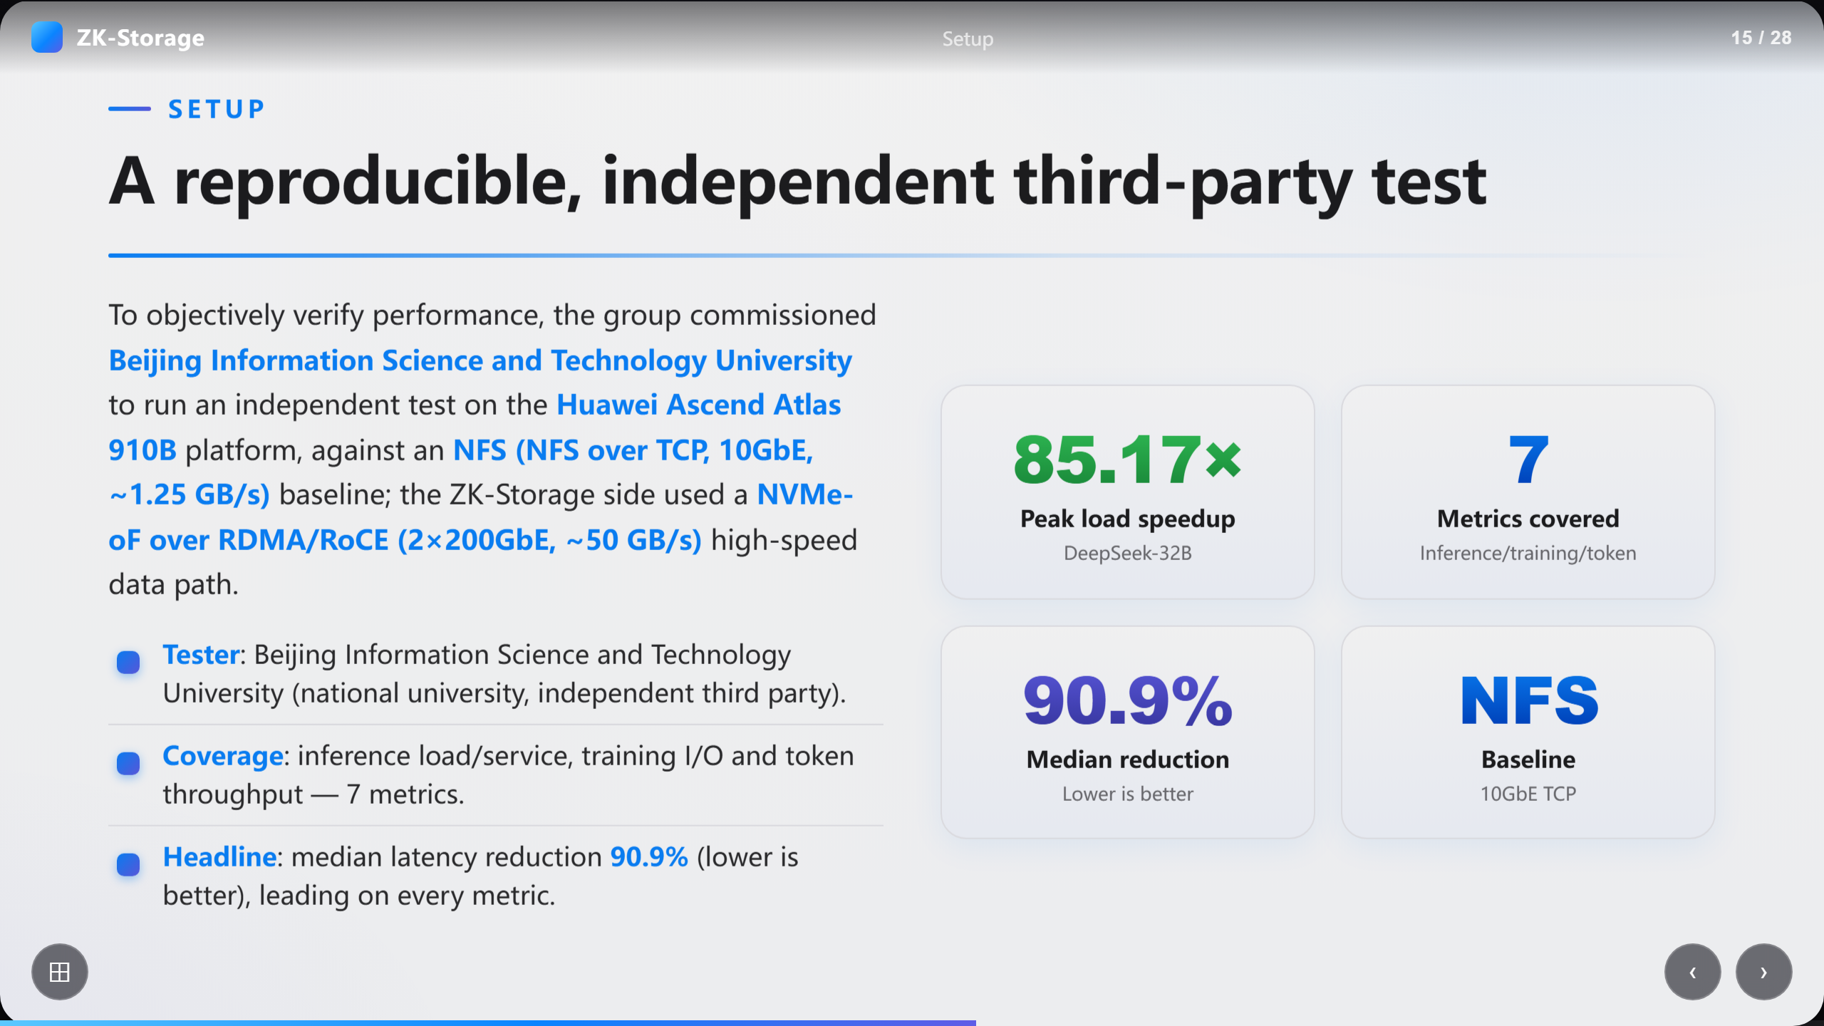
Notes:
A reproducible, independent third-party test

Slide 16
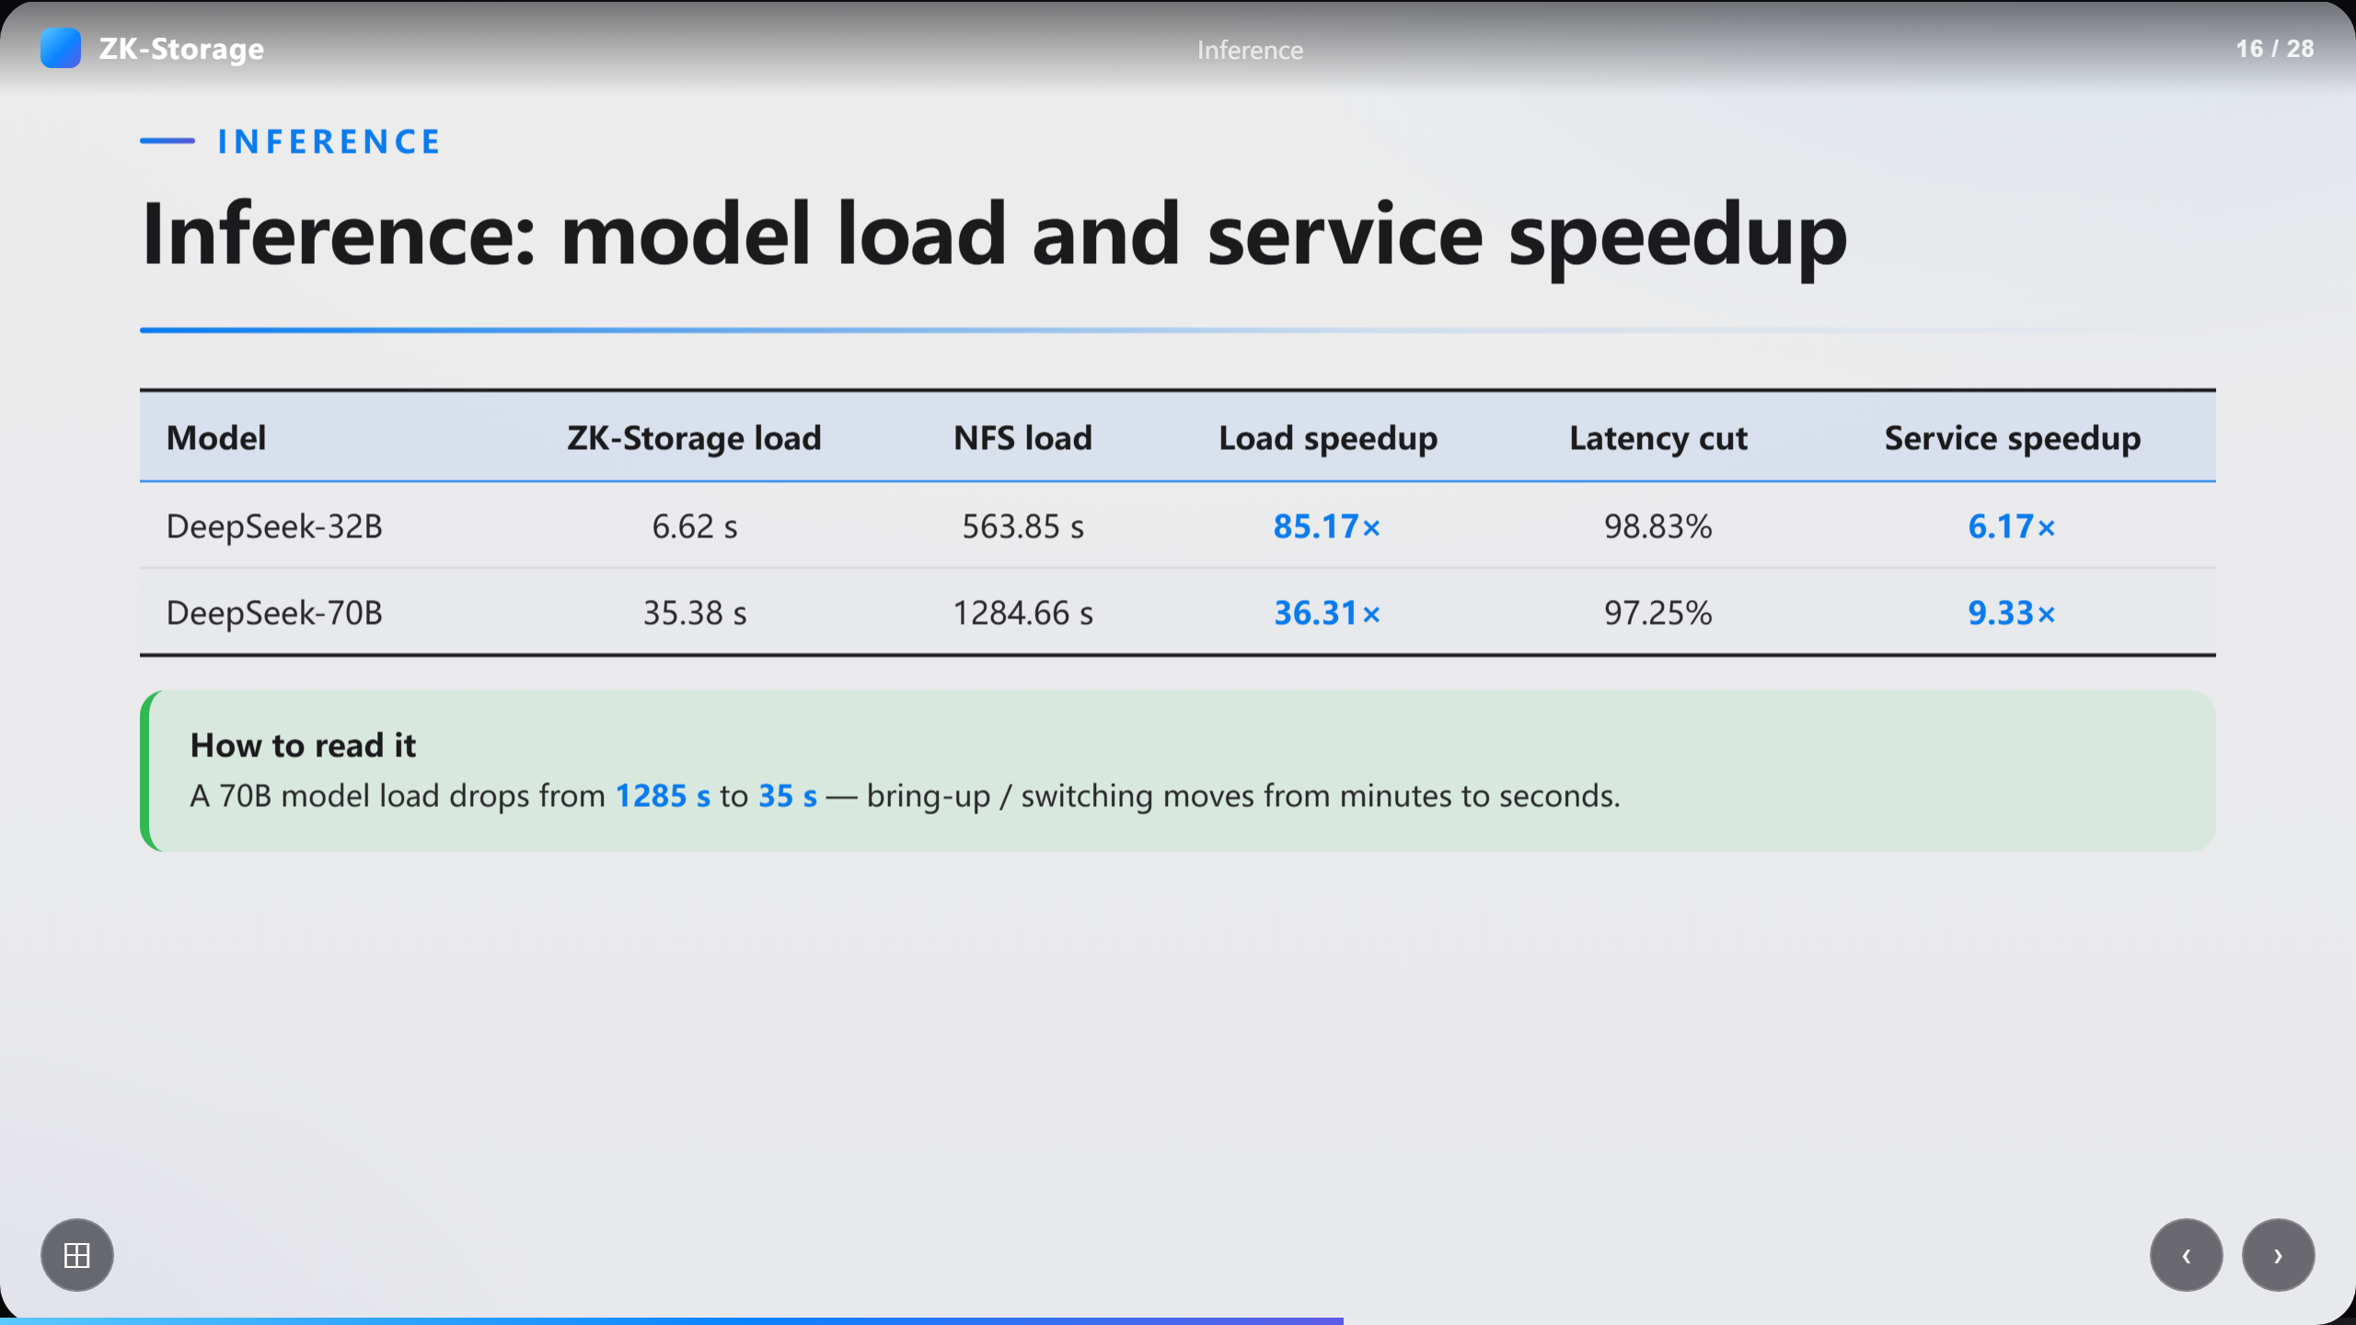
Notes:
Inference: model load and service speedup

Slide 17
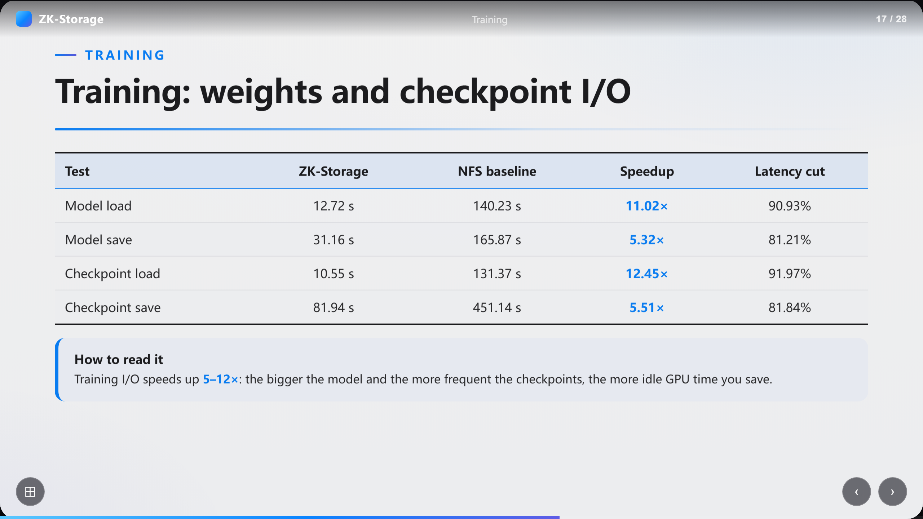
Notes:
Training: weights and checkpoint I/O

Slide 18
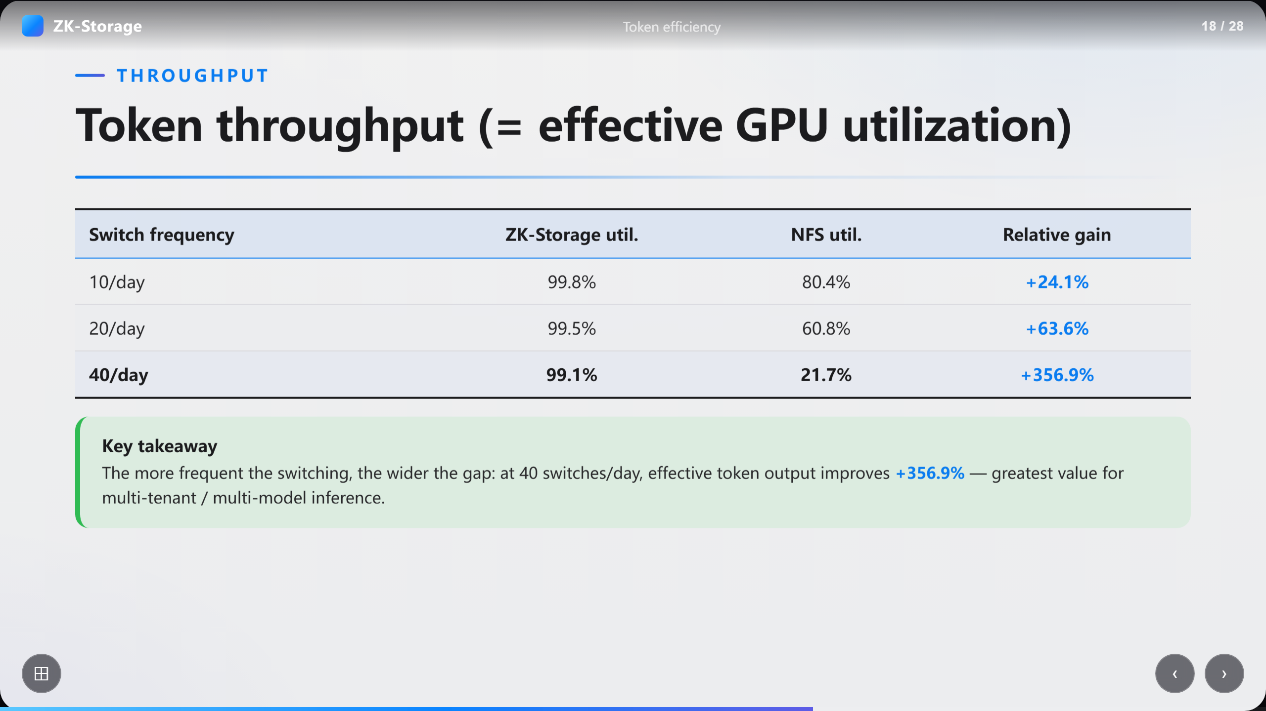
Notes:
Token throughput (= effective GPU utilization)

Slide 19
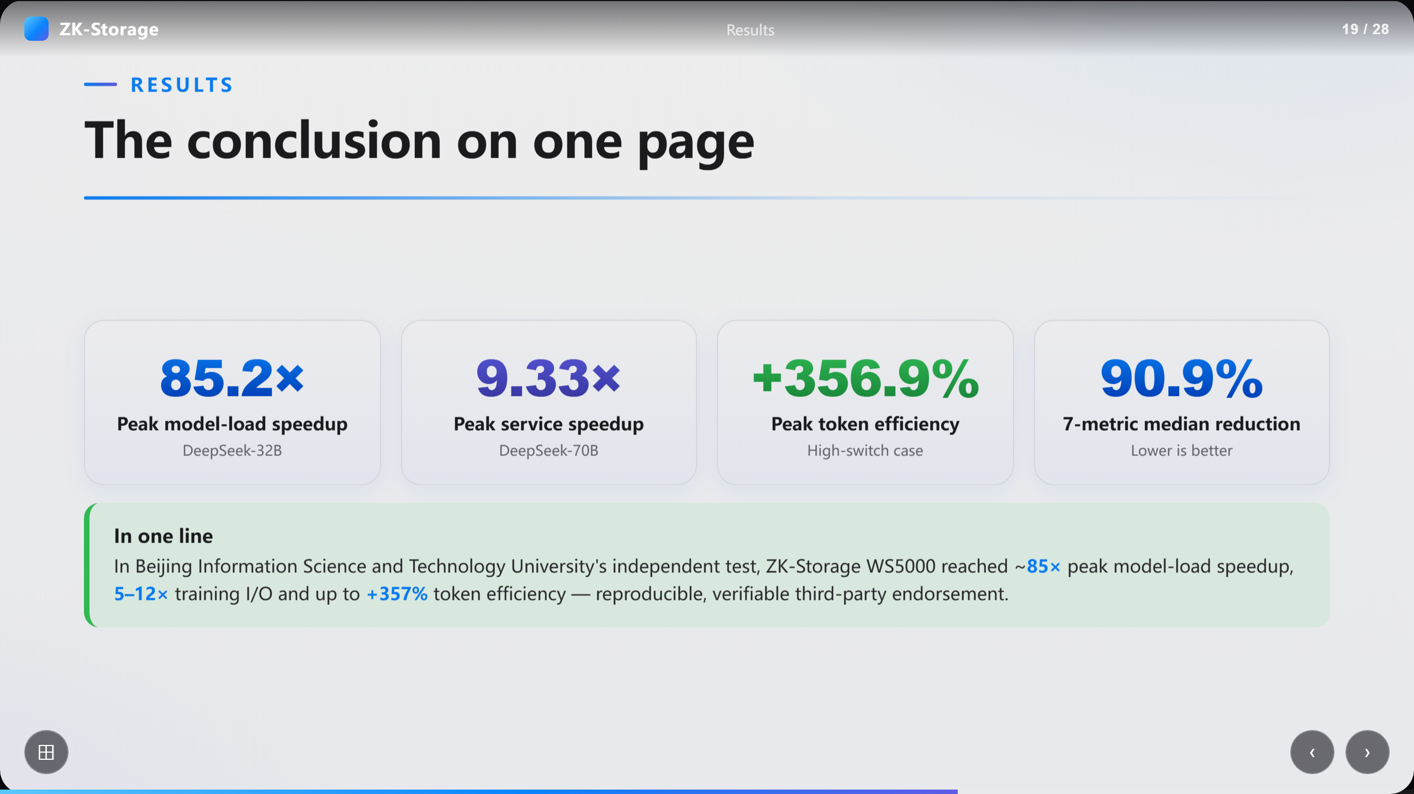
Notes:
The conclusion on one page

Slide 20
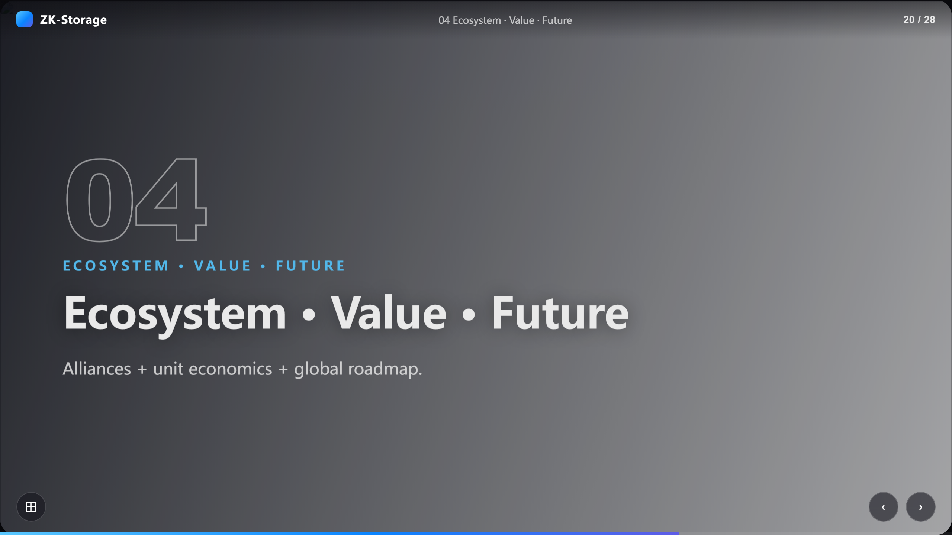
Notes:
Ecosystem · Value · Future

Slide 21
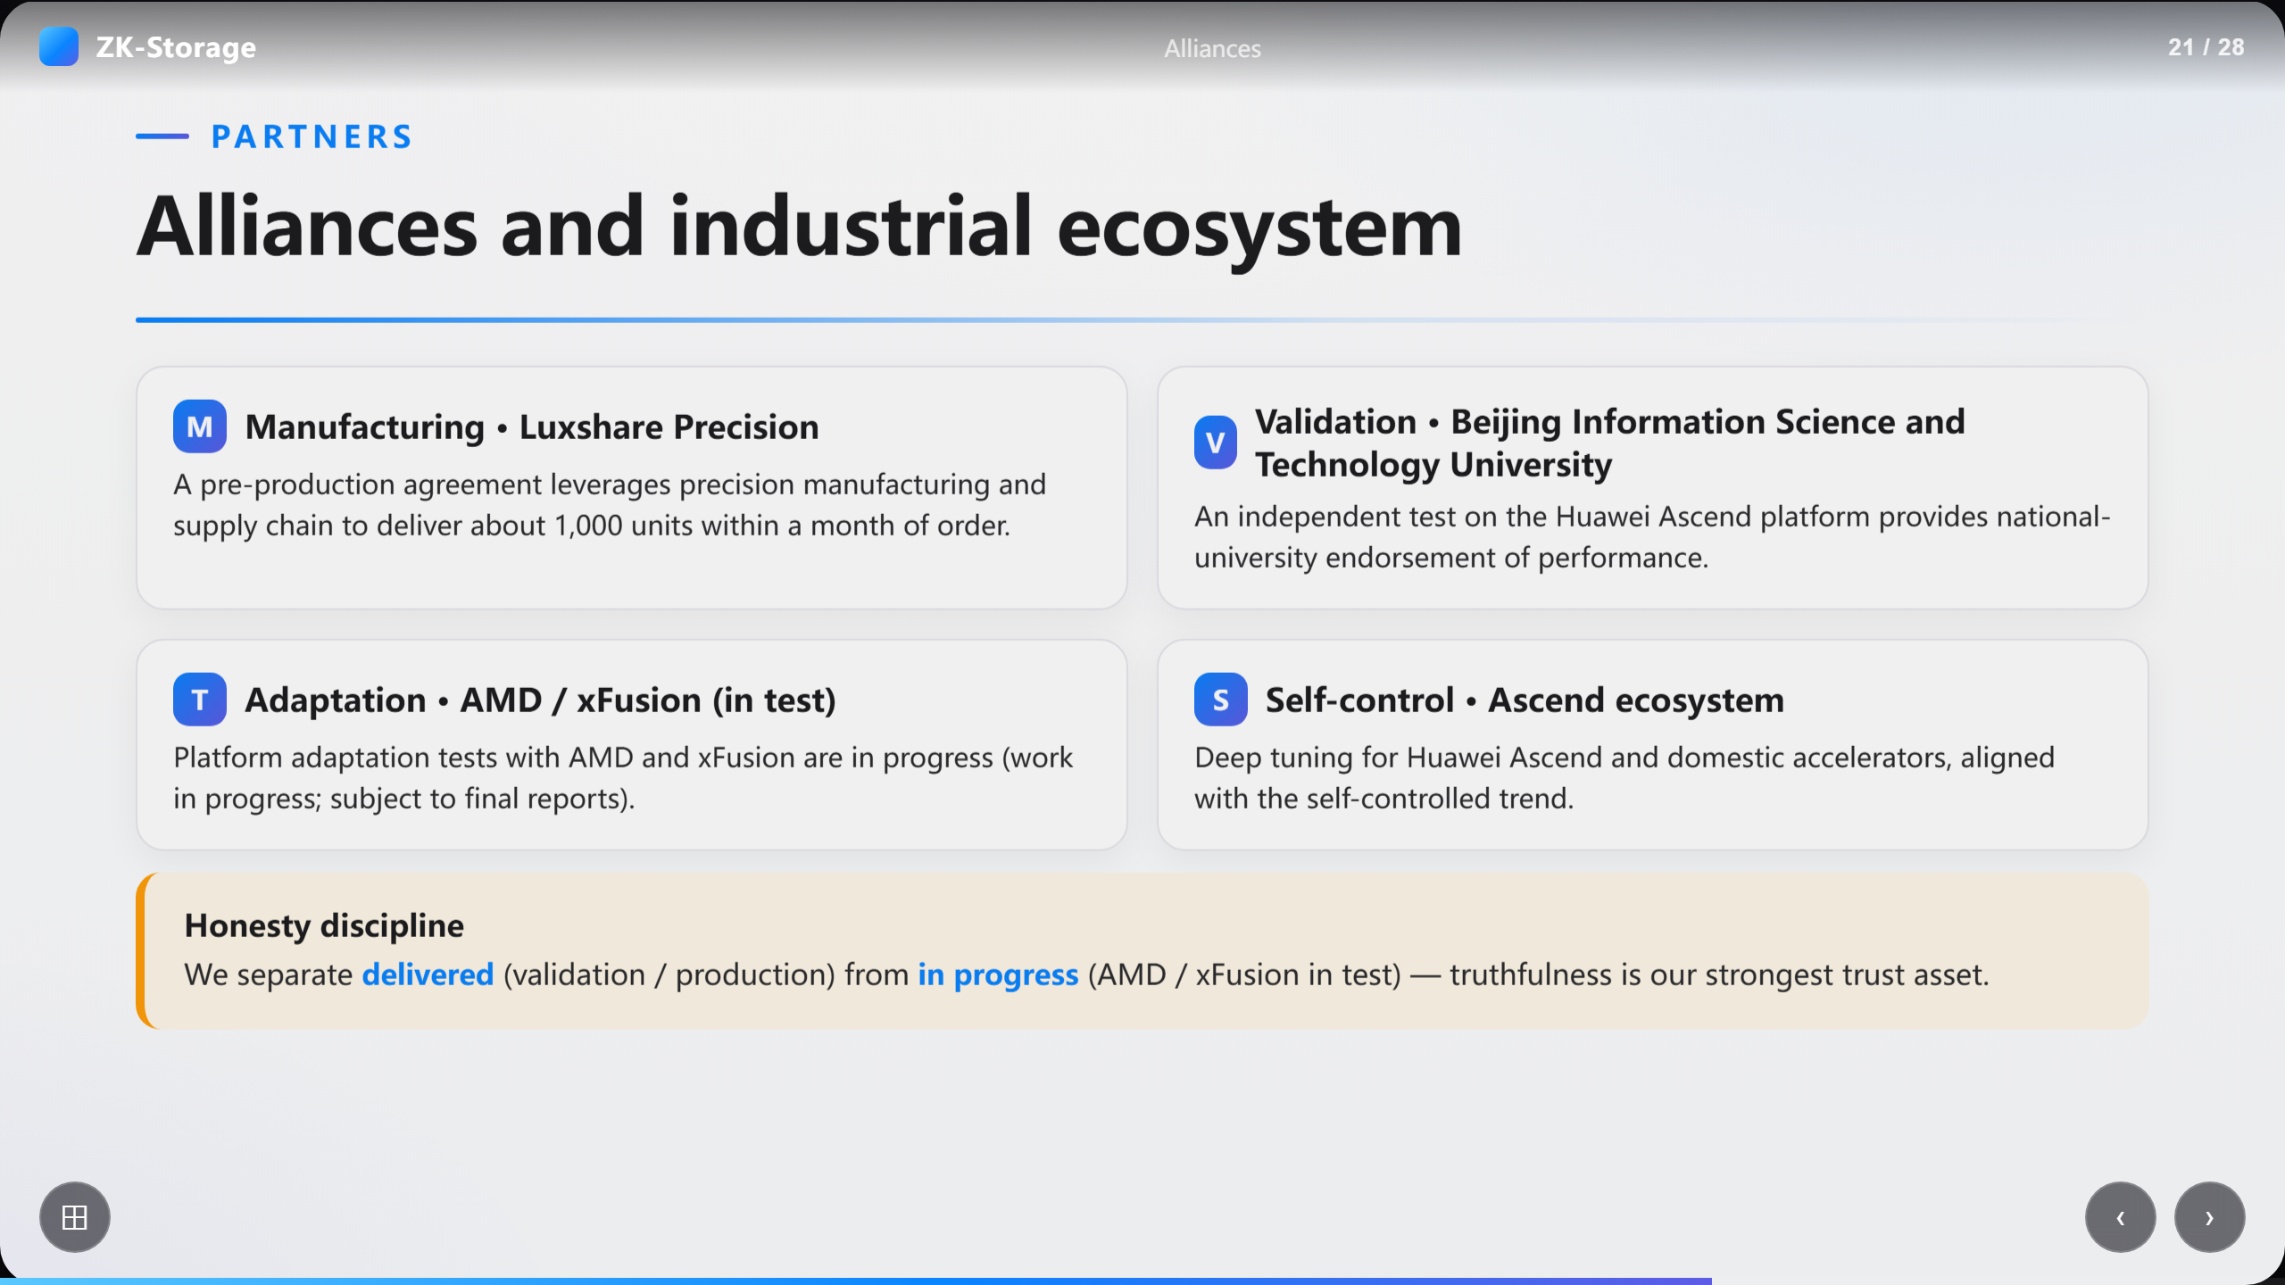
Notes:
Alliances and industrial ecosystem

Slide 22
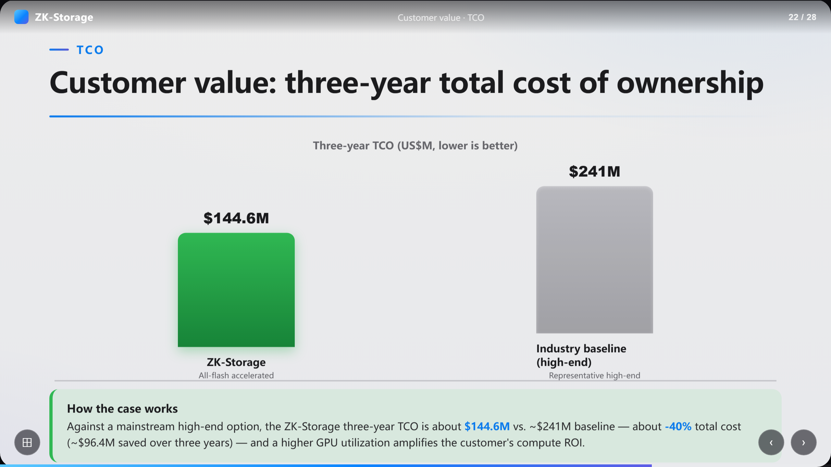
Notes:
Customer value: three-year total cost of ownership

Slide 23
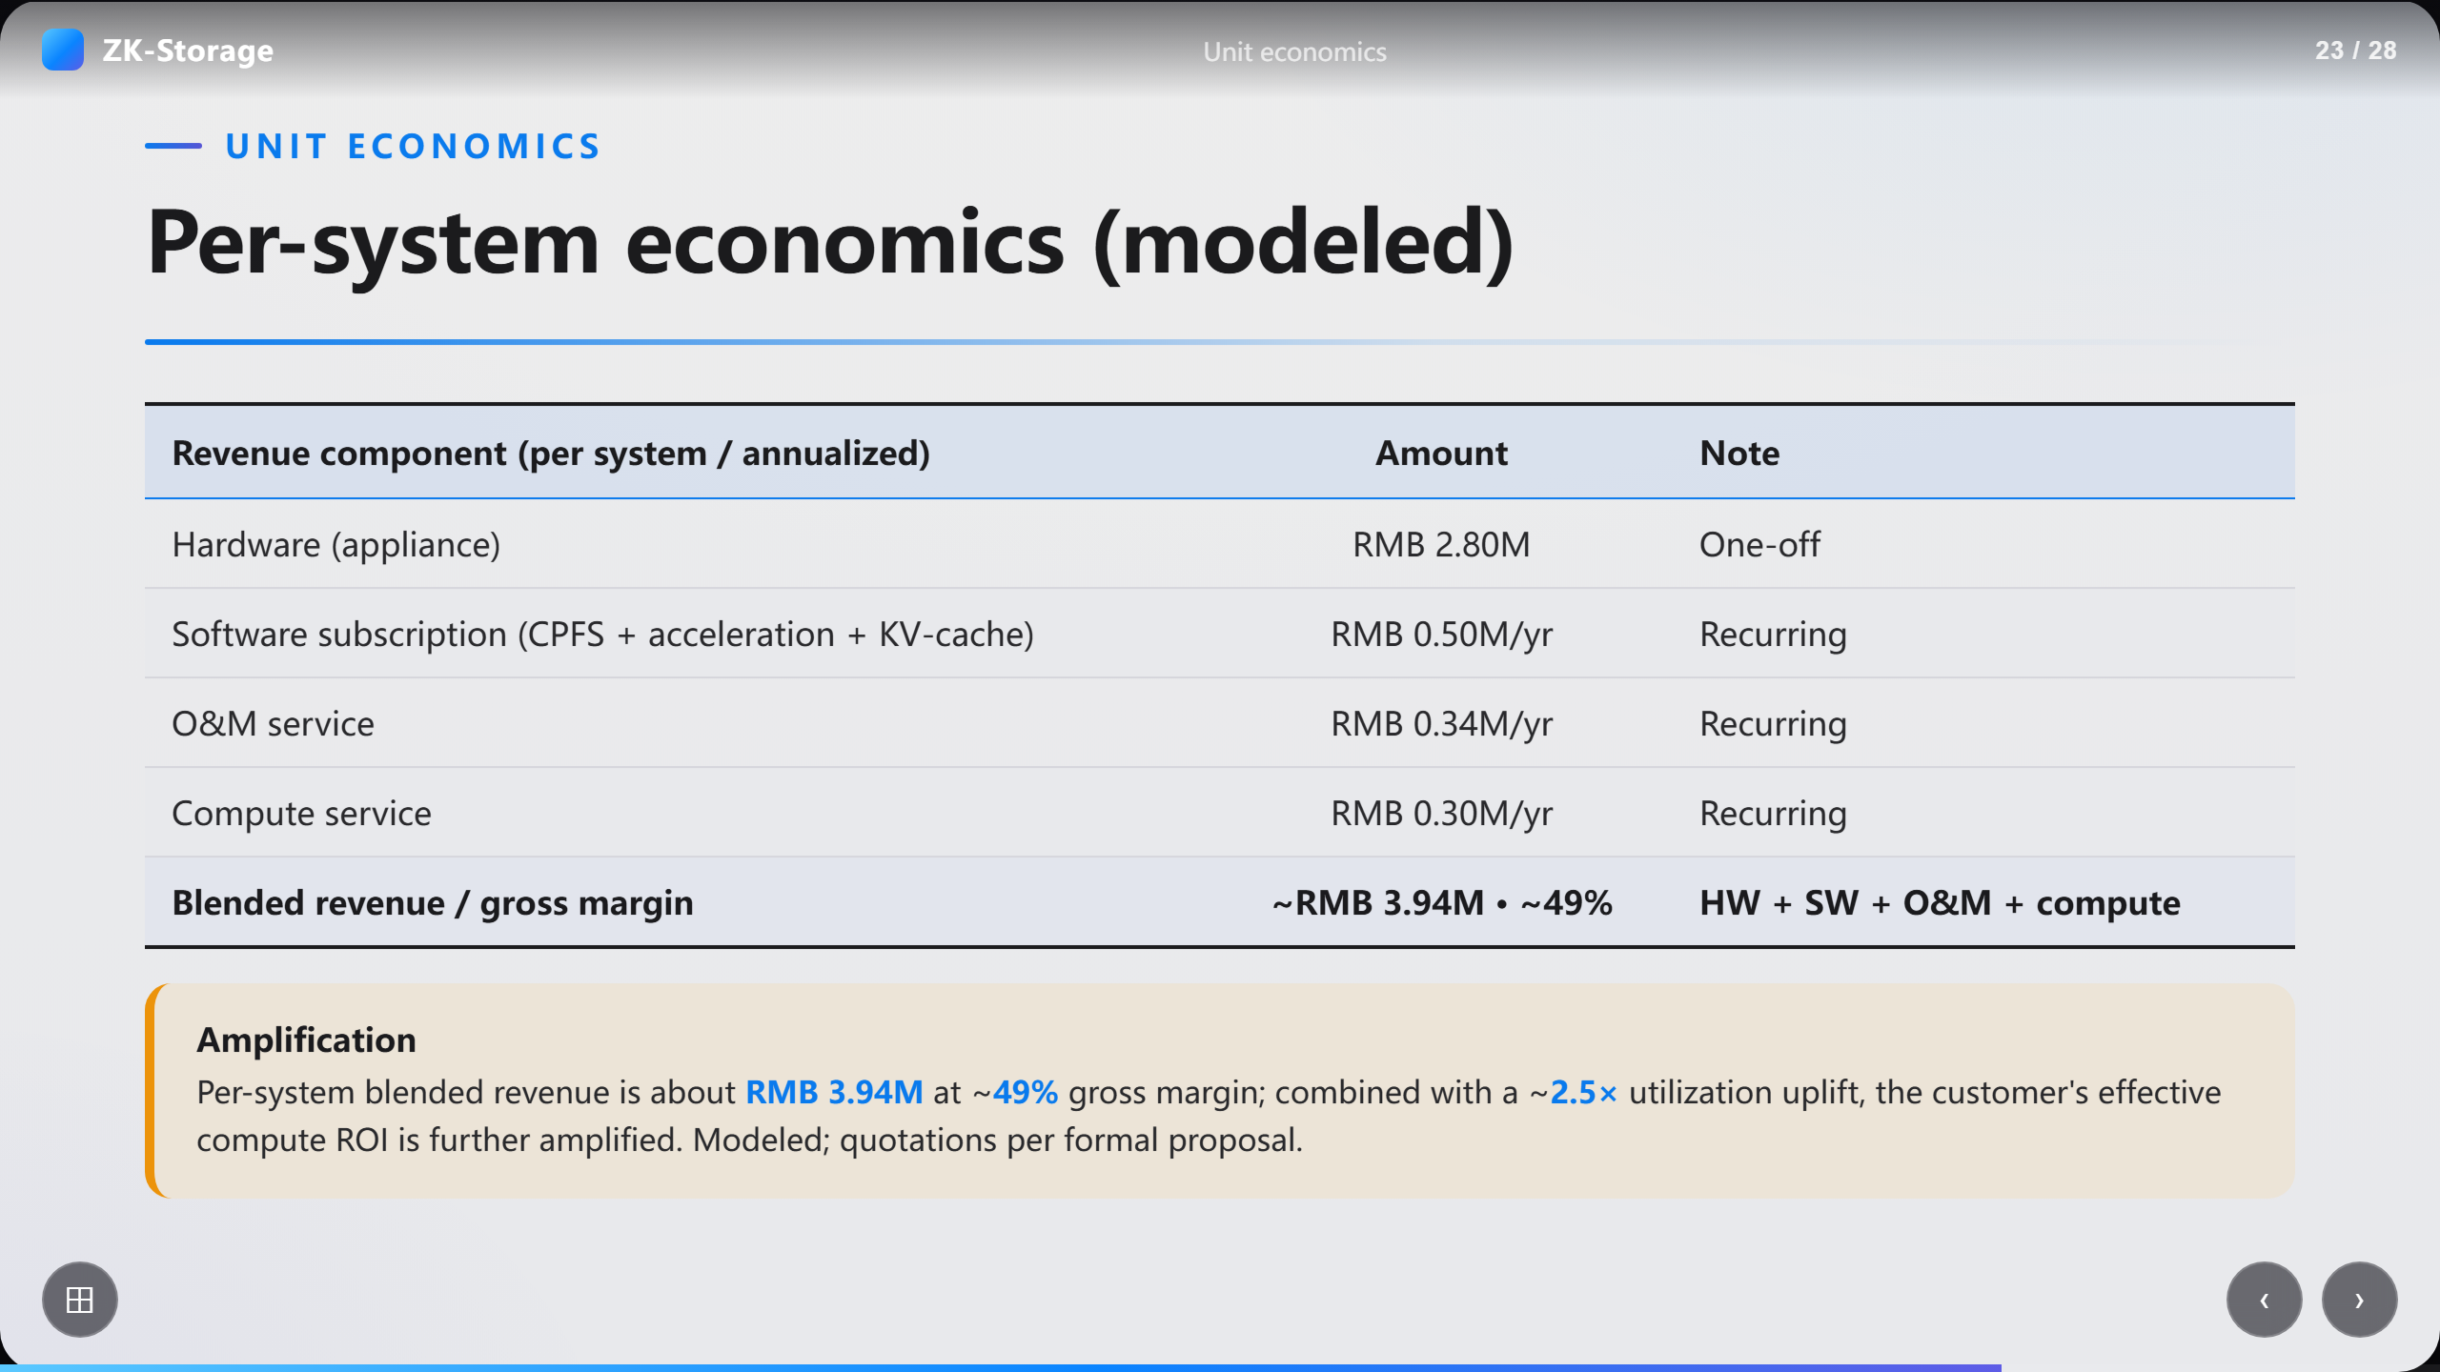
Notes:
Per-system economics (modeled)

Slide 24
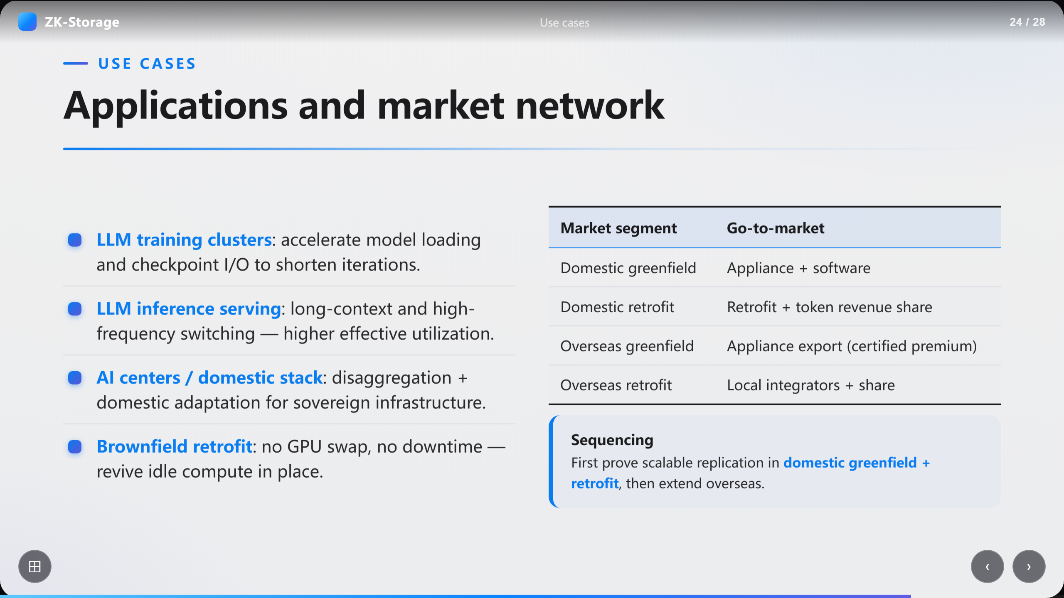
Notes:
Applications and market network

Slide 25
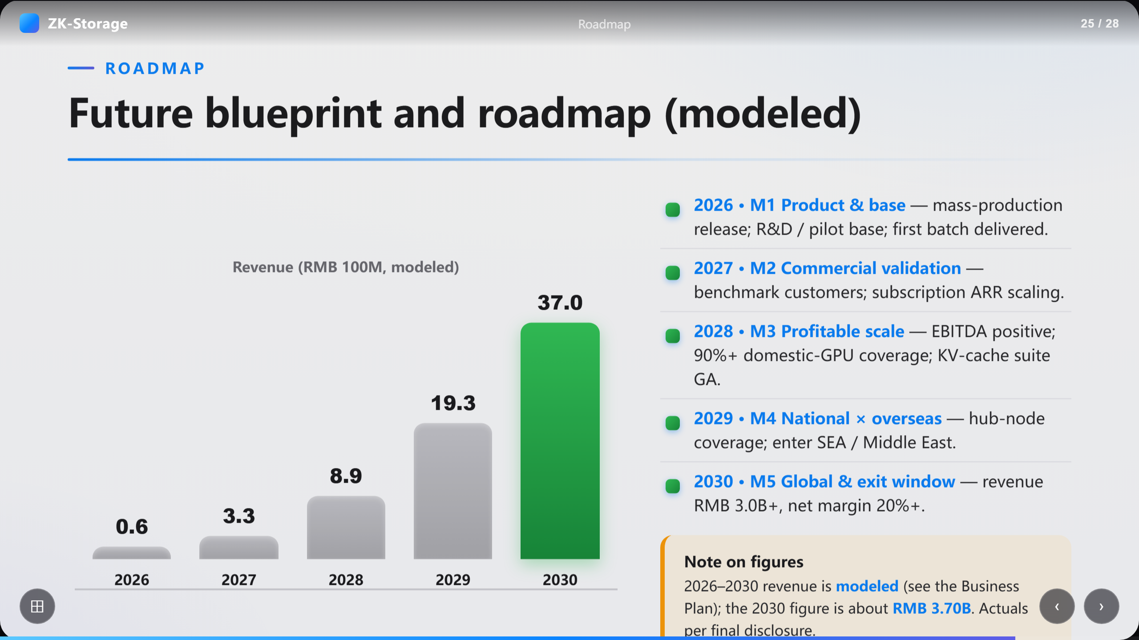
Notes:
Future blueprint and roadmap (modeled)

Slide 26
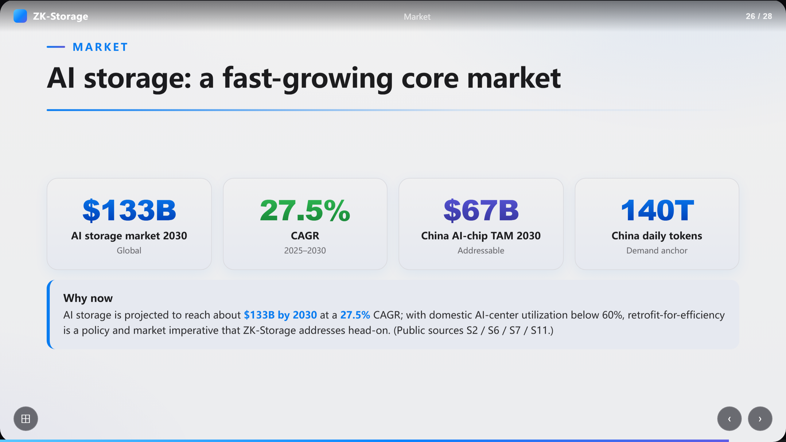
Notes:
AI storage: a fast-growing core market

Slide 27
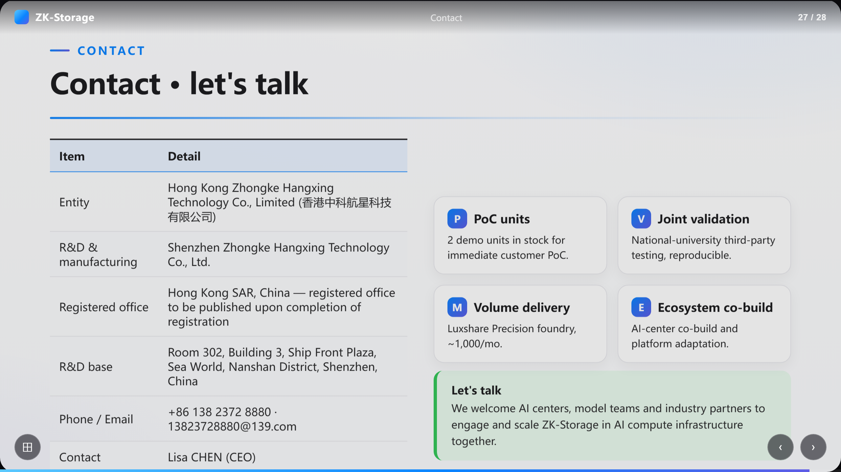
Notes:
Contact · let's talk

Slide 28
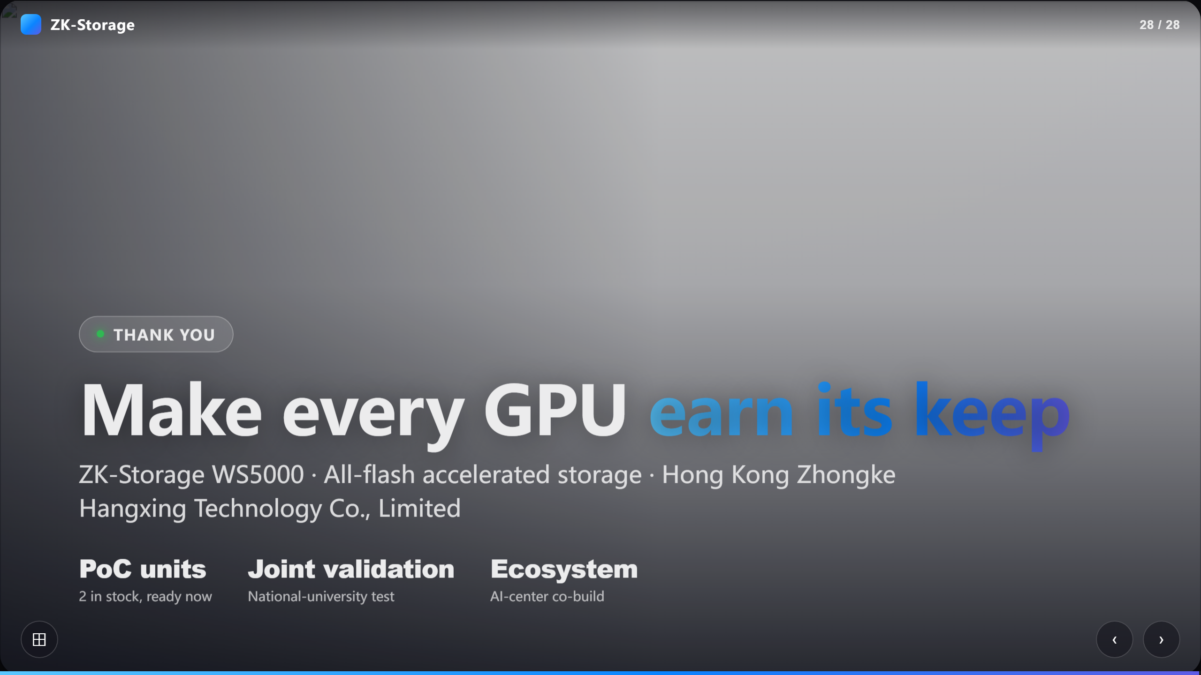
Notes:
Make every GPU earn its keep

